Slide 1
Module 2: Basics of Generative AI
Fall 2025

Slide 2
Outline
Intuition
Basics of Probability
Natural Language Sequence Modeling
Word and Sentence Embeddings

Slide 3
What is Generative AI?
In the simplest terms, Generative AI models create new data that is similar to a given dataset.
Consider some names sampled from a dataset:
Jupiter
Saturn
Pluto
Mercury
Mars
Can you generate other similar names?

Slide 4
What is Generative AI?
There is often no single correct answer when it comes to recognizing patterns in data. Often, identifying the pattern becomes easier when you understand the context or the hidden structure behind the data.
For example:
What if the names come from an Astronomy textbook? In this case, the names might correspond to celestial bodies like stars, constellations, or planets.
What if the names come from a Greek and Roman Mythology textbook? Here, the names could be those of gods, goddesses, or mythological creatures.

Slide 5
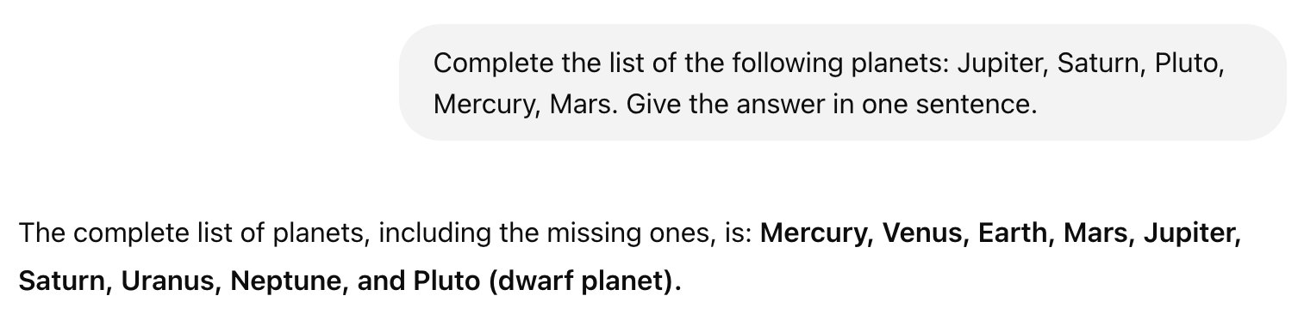
The Context
If we want to generate new data, it will depend on this context.
The ability to create new but contextually consistent data is what makes Generative AI powerful for tasks like text completion, image synthesis, and even music. composition.
Example with ChatGPT

Slide 6
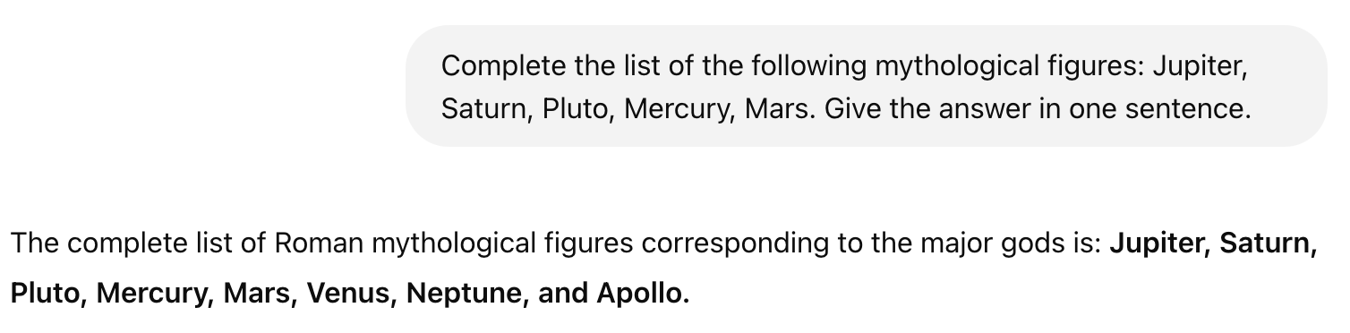
Context Matters
Example with ChatGPT

Slide 7
Add just enough uncertainty…
Design of these powerful models requires some understanding of probability theory.
The models can learn the underlying probability distributions of the data, allowing them to generate new samples.
For example, in text generation the model estimates the probability of each word occurring given the previous ones. We can then sample from these probabilities to construct new words (or tokens) that follow the same patterns as the words in the training data.
By leveraging probability theory, Generative AI models can balance creativity and realism, producing outputs that are both novel and contextually appropriate.

Slide 8
Basics of Probability

Slide 9
Basics of Probability
To discuss/predict future events, we need the concept of Probability. How should we define it?
Regular variables have one value at a time, e.g. X = 5.
Random or Stochastic variables allow us to deal with unknown quantities/events and instead assign to each possibility a probability P.
To be useful, this probability should follow certain rules.
Let’s explore them with a game…

Slide 10
Treasure Game
Let’s use a random variable X to model which one of the boxes contains a treasure.
Don’t worry, I will give hints…
Red box - no treasure
Green box - treasure
We will use X to describe our belief of where the treasure is.

Slide 11
Example 1
Here we know for certain that the treasure is in box 2.
Some rules:
Use P(X = …) = 1 to mean that X = … is certain
Use P(X = …) = 0 to mean that X = … is impossible.
Let’s define a random variable that encodes our belief about the treasure location:
P (X = 1) = 0
P (X = 2) = 1
P (X = 3) = 0
Note: when we define a random variable we give probabilities of its values.
1
2
3

Slide 12
Example 2
Here, things are more interesting, the treasure could be in box 2 or 3.
Use P(X = …) between 0 and 1 to represent our belief of where the treasure is.
P(X = A or B) = P(X = A) + P(X = B)
What do we know for certain about X?
P (X = 1) = 0
P (X = 2 or 3) = 1
Possible definition of X:
P (X = 1) = 0, P (X = 2) = ½, P (X = 3) = ½
As long as we keep P(X = 2 or 3) = P(2) + P(3) = 1, we can adjust the probabilities if we want to represent the belief that box 3 might be a bit more likely to contain the treasure, for example.
1
2
3

Slide 13
Example 3
Define a new random variable Y to describe our belief about the color of box 2.
Some more rules:
Use P(X = … | Y = …) to mean:
Probability that X = … GIVEN THAT Y = …
P (X=..., Y = …) probability that X = … AND Y = …
P(A AND B) = P(A | B) P(B)
P(A AND B) = P(A) P(B) if A and B are independent
What do we know for certain about X and Y?
P (X = 1| Y = GREEN) = ?
P (X = 2 | Y = RED) = ?
P (X = 2 | Y = GREEN) = ?
P (X = 1 or X = 3 | Y = GREEN) = ?
1
2
3

Slide 14
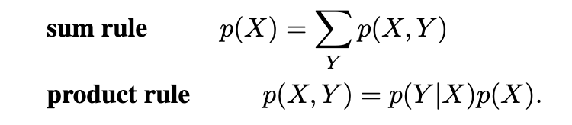
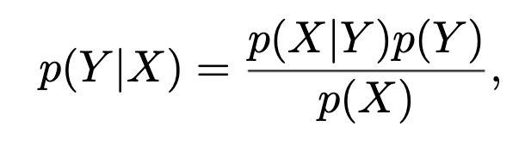
Fundamental Rules of Probability
Bayes Theorem helps us to represent our belief about the world based on evidence and data:

Slide 15
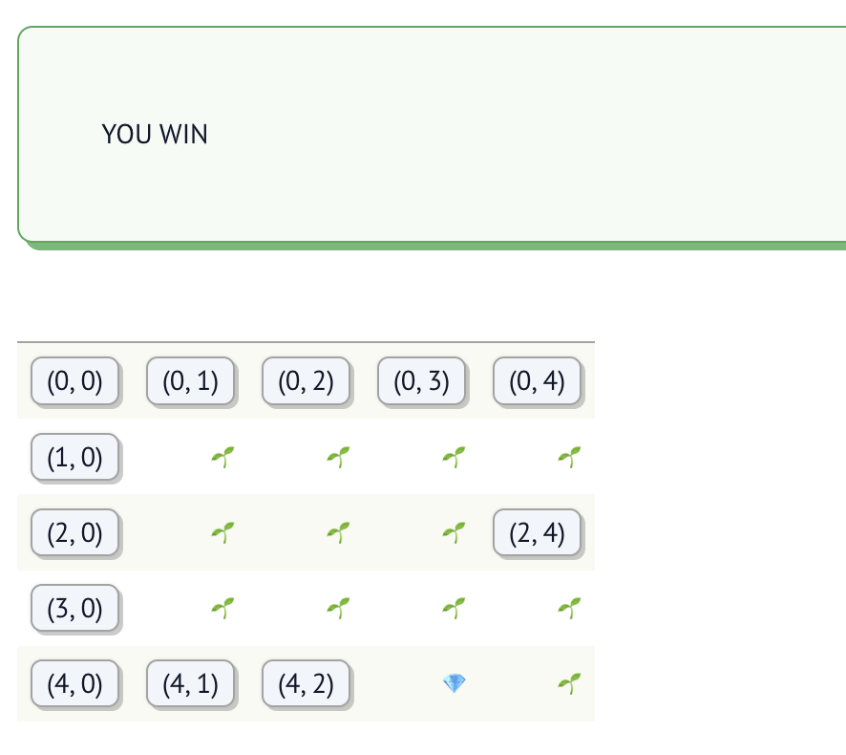
Probability Practical
Interactive Notebook
Bayes Theorem is fundamental in calculating probabilities of latent variables based on observable data, for example localizing a self-driving car based on noisy sensor information. While we will not use it directly, the following activity will help us practice with concepts of probability and likelihood that will play an important role in the following modules.

Slide 16
Natural Language Sequence Modeling

Slide 17
Probabilities in Language Modeling
P(word1, word2, word3, …)
Some notation:
Use P(“book”) as a shorthand for P(X_{i} = “book”), where X_{i} is a random variable representing the ith word.
So P(“New”, “York”) is the probability that P(X₁ = “New” and X₂ = “York”), i.e. that the first word is “New” and the second word is “York”.
Let’s come up with rough estimates (rank most probable -> least probable)
P( “Sam”, “went”, “to”, “the”, “supermarket” )
P( “Sam”, “car”, “supermarket” )
P (“Sam”, “swam”, “to”, “the”, “supermarket”)

Slide 18
Probabilities in Language Modeling
P(word | context)
Some notation:
P(“tea” | “green”) is the probability that P(X₂ = “tea” | X₁ = “green”), i.e. that the second word is “tea” given that the first word is “green”.
P (“Paris” | “The”, “capital”, “of”, “France”, “is”) is a shortcut for P(X₆ = “Paris” | X₁ = “The”, X₂ = “capital”, X₃ = “of”, X₄ = “France”, X₅ = “is”)
Let’s give rough estimates (high probability or low probability)
P( “Toyota” | “My name is” ) = LOW OR HIGH?
P( “John” | “My name is” ) = LOW OR HIGH?

Slide 19
Probabilities in Language Modeling
Markov Assumption
Example:
Interactive Notebook
Remember the product rule?
P(X₁…X_{n}) = P(X₁) * P(X₂ | X₁) * P(X₃ | X_{1:2}) ….
This means to model probabilities correctly we have to track all of the context from the very first word.
To simplify things, it is common to add the Markov Assumption:
P(w_{n} | w_{1:n-1}) = P(w_{n} | w_{n-1})
I.e. each consecutive word only depends on the previous one - this is the bigram model.
Can also use several previous ones: n-gram model.
Modern LLM systems can have context sizes of 128,000 tokens or more.

Slide 20
Word and Sentence Embeddings

Slide 21
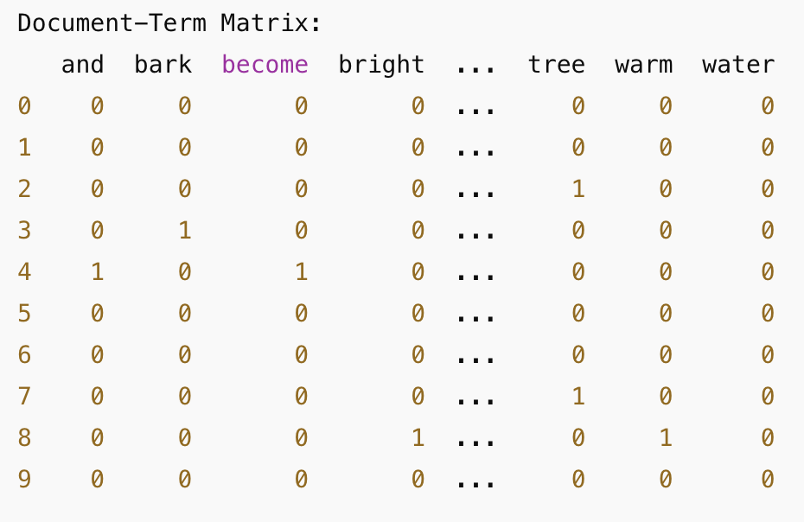
Word Embeddings
In Methods and Frameworks II, you explored how to generate numeric representations of words using a Document-Term Matrix—also known as Vector Representations—which map words into vectors within an n-dimensional space based on the term frequency of their occurrence in a given document..

Slide 22
Sparse Embeddings
However, these representations come with several limitations:
High Dimensionality: The dimension of each vector corresponds to the size of the vocabulary obtained after preprocessing steps like stemming and stopword removal. This often results in extremely sparse and high-dimensional vectors, making computations resource-intensive.
Lack of Contextual Information: These vectors treat words in isolation, so the vector representation of "table" is as different from "desk" as it is from "orange"—even though "table" and "desk" are semantically related. This inability to capture context limits their effectiveness in understanding word meanings.

Slide 23
Word2Vec
One of the pivotal efforts to address these challenges was a highly influential 2013 paper from Google titled, “Efficient Estimation of Word Representations in Vector Space.”
The core idea was to project high-dimensional word representations into a lower-dimensional space, ensuring that words with similar meanings are mapped to vectors that are close according to a similarity measure, such as Euclidean distance or cosine similarity.
These mappings are called “embeddings,” a term borrowed from the field of Topology in mathematics. Conceptually, these embeddings can also be understood as latent representations of the original vectors, capturing the underlying semantic relationships between words.

Slide 24
Sentence Embeddings and Information Retrieval
For tasks such as Information Retrieval and Retrieval-Augmented Generation (RAG)—topics we will explore in the next module—we need to construct embeddings not just for individual words, but for entire sentences and even larger documents.
One straightforward approach to achieve this is to average the embedding vectors of all the words in the document. By aggregating the word embeddings, we can create a single, unified vector that captures the overall semantic meaning of the entire sentence or document.

Slide 25
Embeddings
Example:
Interactive Notebook
In modern NLP systems text is divided into subunits called tokens, rather than words. For now we will work with word tokens to keep things simple.
Word2Vec paved the way to many other embedding implementations.
For simplicity we will start with spacy implementation and later experiment and learn how to implement more advanced embeddings provided by the latest Large Language Models (LLM).

